Slide 1

Lecture 4: Description logic = logic for ontologies
Frank van Harmelen
Vrije Universiteit Amsterdam

Slide 2
Our story so far
In the self-study lecture you have seen
Ontologies: a hierarchical representation of types (“classes”), with instances (“individuals”) that belong to classes, and properties between the individuals.
A number of realistic examples of ontologies in use
These ontologies are easy to read by people
This lecture: But can we also make a logic for ontologies, so that computers can reason automatically?

Slide 3
What do we need for a logic?
A language (“syntax”), so that we can write down expressions
A definition of the meaning of expressions (“semantics”)
Inference (“deduction”) so that we can derive new conclusions
Today = 1+2
Next week = 3

Slide 4
What do we need for a logic? (example of propositional logic)
A language (“syntax”), so that we can write down expressions in PL: (p -> q), (p or q) and (r or not q), …
A definition of the meaning of expressions (“semantics”) in PL: p=0, q=1, …
Inference (“deduction”) so that we can derive new conclusions in PL: truth-table method, Davis Putnam, GSAT, …
Today = 1+2
Next week = 3

Slide 5
Description Logic = a logic for ontologies
Description Logics are
a family of knowledge representation formalisms
that represent knowledge about an application domain
as a hierarchy of concepts
and a description of the properties of the objects
(Description Logic Handbook)
We will only look at the simplest member
of this family of formalisms

Slide 6
Make sure the logic is not too simple, and not too complex
First-order logic
(very expressive, very expensive) (undecidable)
Description logic
(decidable)
Propositional logic
(very inexpressive, very cheap) (decidable)

Slide 7
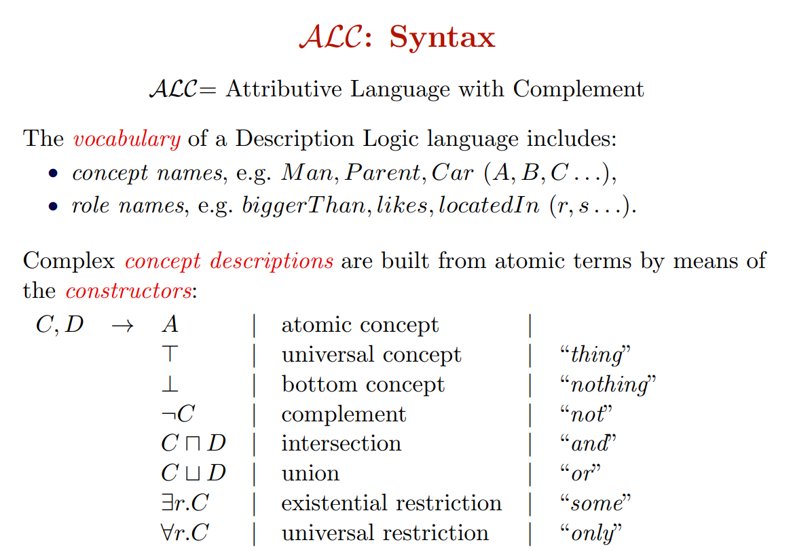
the simplest Description Logic
classes,types
properties
C

Slide 8
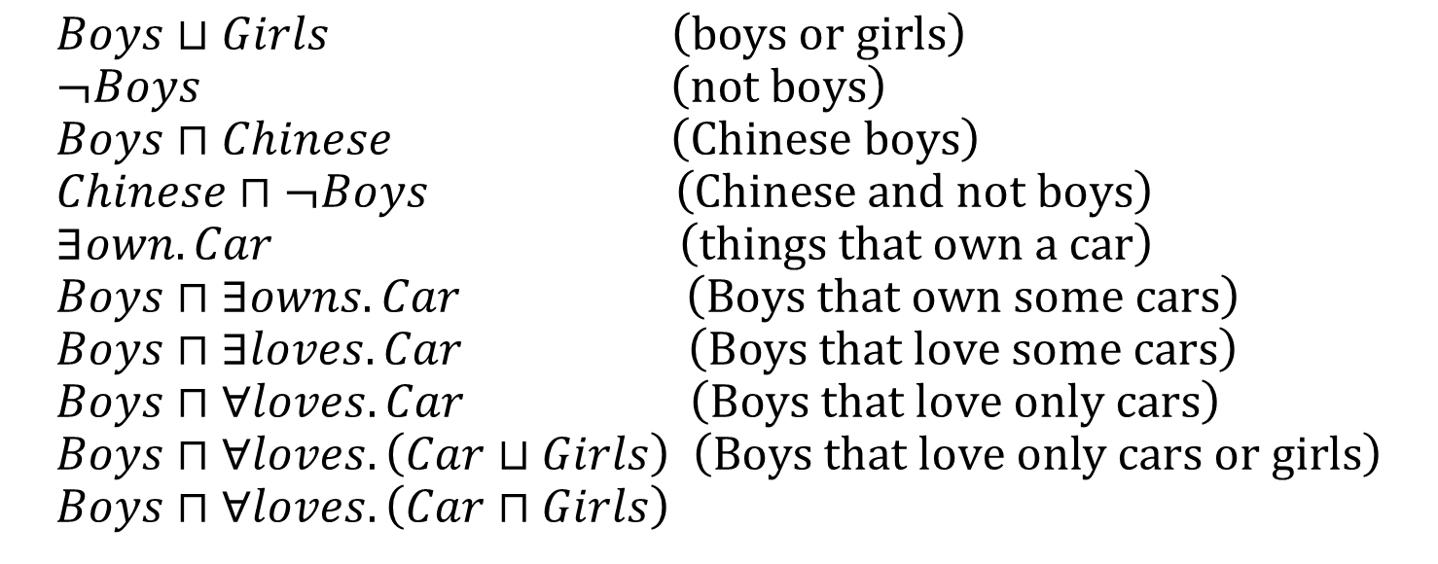
Examples
$$Boys⊔Girls \left(\text{boys} \text{or} \text{girls}\right) \\ ¬Boys \left(\text{not} \text{boys}\right) \\ Boys⊓Chinese \left(\text{Chinese} \text{boys}\right) \\ Chinese⊓¬Boys \left(\text{Chinese} \text{and} \text{not} \text{boys}\right) \\ ∃own.Car \left(\text{things} \text{that} \text{own} \text{a} \text{car}\right) \\ Boys⊓∃owns.Car \left(\text{Boys} \text{that} \text{own} \text{some} \text{cars}\right) \\ Boys⊓∃loves.Car \left(\text{Boys} \text{that} \text{love} \text{some} \text{cars}\right) \\ Boys⊓∀loves.Car \left(\text{Boys} \text{that} \text{love} \text{only} \text{cars}\right) \\ Boys⊓∀loves.\left(Car⊔Girls\right) \left(\text{Boys} \text{that} \text{love} \text{only} \text{cars} \text{or} \text{girls}\right) \\ Boys⊓∀loves.\left(Car⊓Girls\right)$$

Slide 9
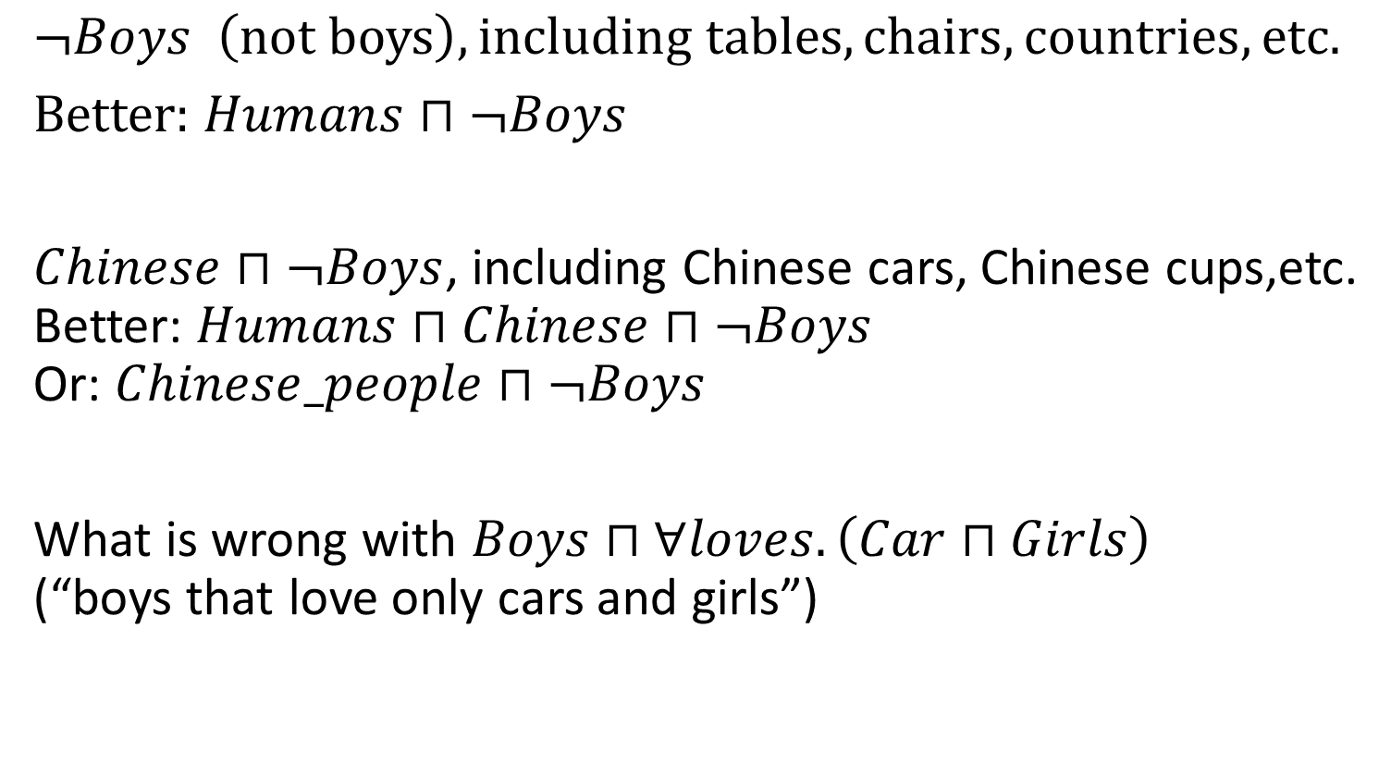
Be careful:
$$¬Boys \left(\text{not} \text{boys}\right), including tables, chairs, countries, etc.$$ Better: $Humans⊓¬Boys$
$Chinese⊓¬Boys$, including Chinese cars, Chinese cups,etc. Better: $Humans⊓$ $Chinese⊓¬Boys$ Or: $Chinese_people⊓¬Boys$
What is wrong with $Boys⊓∀loves.\left(Car⊓Girls\right)$ (“boys that love only cars and girls”)

Slide 10
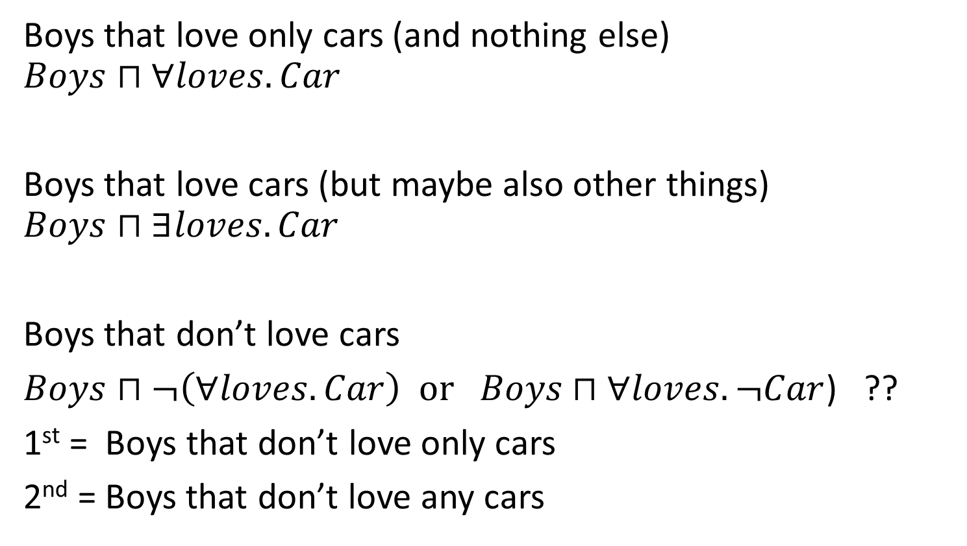
Be careful:
Boys that love only cars (and nothing else)
$$Boys⊓∀loves.Car$$
Boys that love cars (but maybe also other things)
$$Boys⊓∃loves.Car$$
Boys that don’t love cars
$Boys⊓¬\left(∀loves.Car\right) \text{or} Boys⊓∀loves.¬Car$) ??
1st = Boys that don’t love only cars
2nd = Boys that don’t love any cars

Slide 11
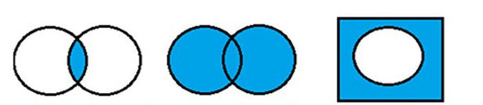



Helpful graphical notation
C
D
C
D
C
$$C⊓D$$
$$C⊔D$$
$$¬C$$

Slide 12


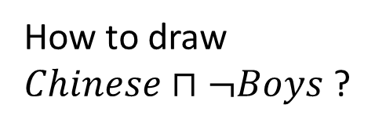


Helpful graphical notation
Boys
Chinese
How to draw $Chinese⊓¬Boys$ ?
Boys
Chinese
$$Chinese$$
Boys
Chinese
$$¬Boys$$
Boys
Chinese
$$Chinese⊓¬Boys$$
$$Chinese$$

Slide 13




Helpful graphical notation for roles
$$∃loves.Car$$
car
$$∀loves.Car$$
car
loves
loves
loves
boy
loves
car
loves
loves
hates
food
hates
car
school
school
car
$$∃loves.¬Car$$
car
$$∀loves.¬Car$$
hates
boy
loves
loves
loves
boy
loves
food
loves
loves
hates
food
music
hates
school
school

Slide 14
How to find the classes & properties (= concepts & roles)
Any artwork is created by an artist
A sculpture is an artwork
A painting is an artwork that is not a sculpture
A painter is someone who painted a painting
A sculptor is someone who sculptured an artwork and only create sculptures
If an artwork is created by an artist, he has either painted it or sculpted it

Slide 15
How to find the classes & properties (= concepts & roles)
Any artwork is created by an artist
A sculpture is an artwork
A painting is an artwork that is not a sculpture
A painter is someone who painted a painting
A sculptor is someone who sculptured an artwork and only create sculptures
If an artwork is created by an artist, he has either painted it or sculpted it
Concepts (= classes,types): Artwork, Artist, Sculptor, Painter, Painting, Sculpture

Slide 16
How to find the classes & properties (= concepts & roles)
Any artwork is created by an artist
A sculpture is an artwork
A painting is an artwork that is not a sculpture
A painter is someone who painted a painting
A sculptor is someone who sculptured an artwork and only create sculptures
If an artwork is created by an artist, he has either painted it or sculpted it
Concepts (= classes,types): Artwork, Artist, Sculptor, Painter, Painting, Sculpture
Roles (= properties): created, created_by, painted, sculptured

Slide 17
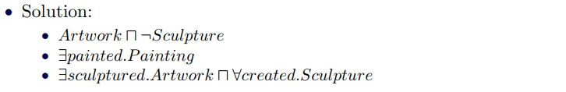
How to define complex concepts & roles?
Concepts: Artwork, Artist, Sculptor, Painter, Painting, Sculpture
Roles: created, created_by, painted, sculptured
An artwork that is not a sculpture
Some who painted a painting
Someone who sculptured an artwork and only created sculptures

Slide 18
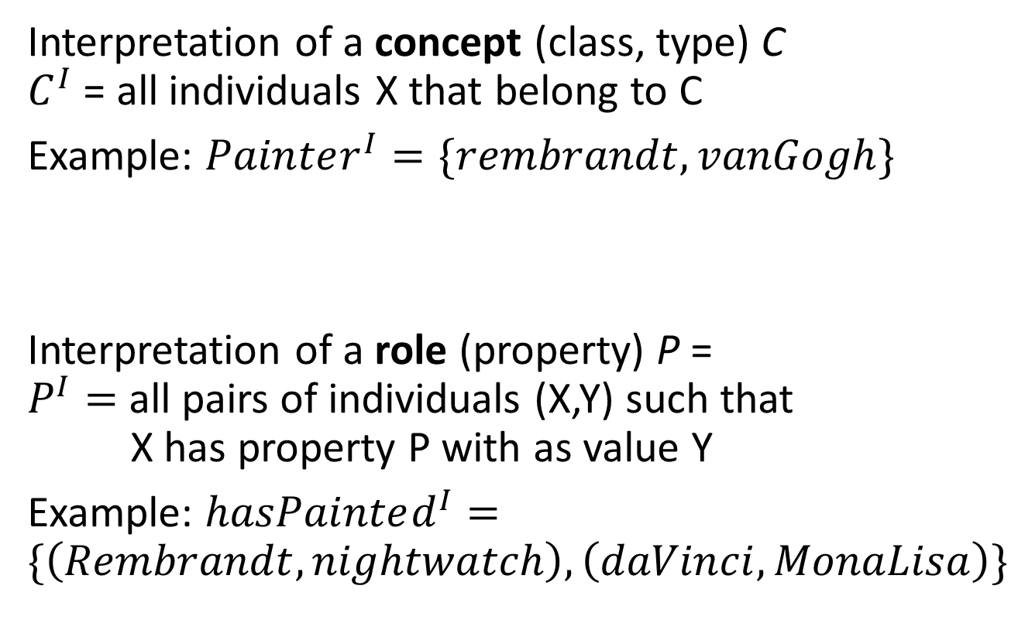
Mathematical meaning (“interpretation”) of concepts and roles
Interpretation of a concept (class, type) C $C^{I}$ = all individuals X that belong to C
Example: $Painter^{I}=\{rembrandt, vanGogh\}$
Interpretation of a role (property) P = $P^{I}=$all pairs of individuals (X,Y) such that X has property P with as value Y
Example: $hasPainted^{I}=\{\left(Rembrandt,nightwatch\right),\left(daVinci,MonaLisa\right)\}$

Slide 19
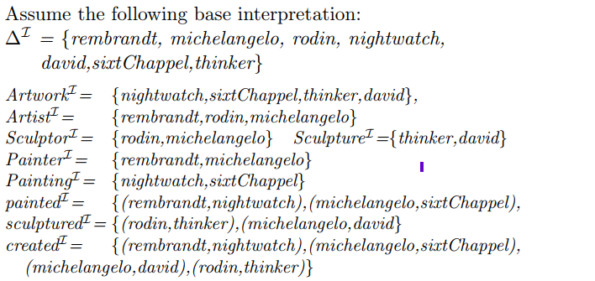
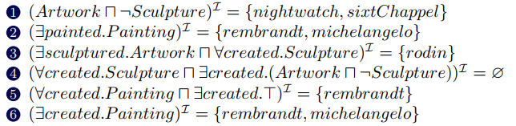
Example

Slide 20
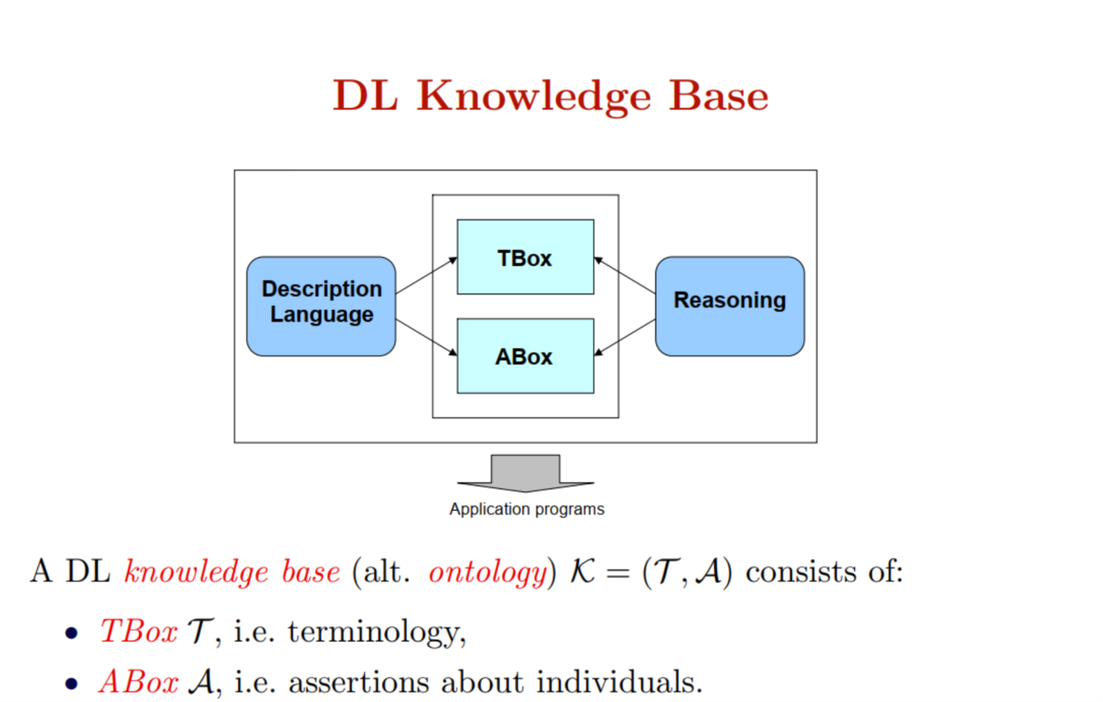

Slide 21
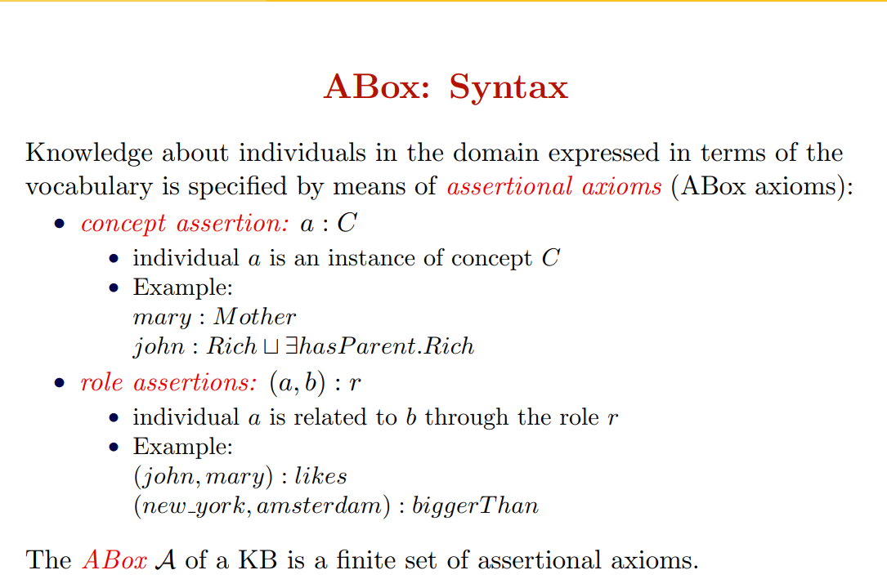

Slide 22
Another example for A-box
Dan, Daisy and Dirk are a doctor
Pat, Paul and Dan are a patient
Daisy treats Pat
Pat is treated by Daisy
Dan suffers from pain and from sickness
Dan:doctor, Daisy:doctor, Dirk:doctor
Pat:patient, Paul:patient, Dan:patient
(Daisy,Pat):treats
(Pat,Daisy):treated_by
(Dan,pain):suffers_from, (Dan, sickness):suffers_from

Slide 23
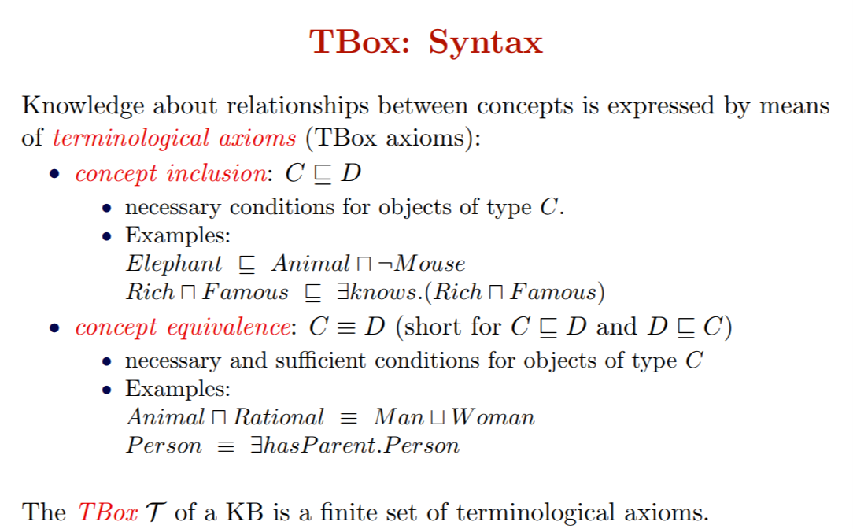

Slide 24
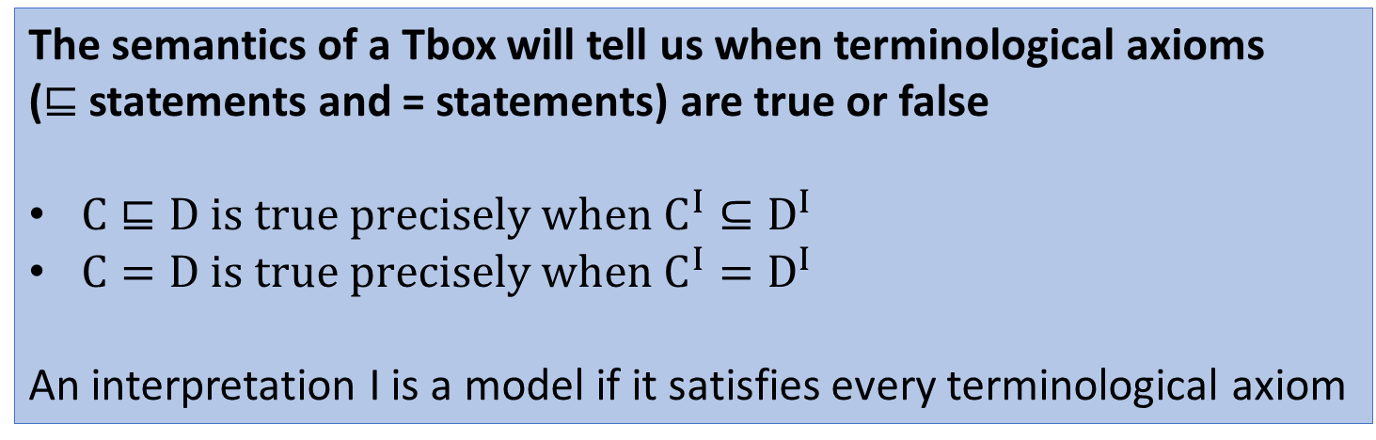
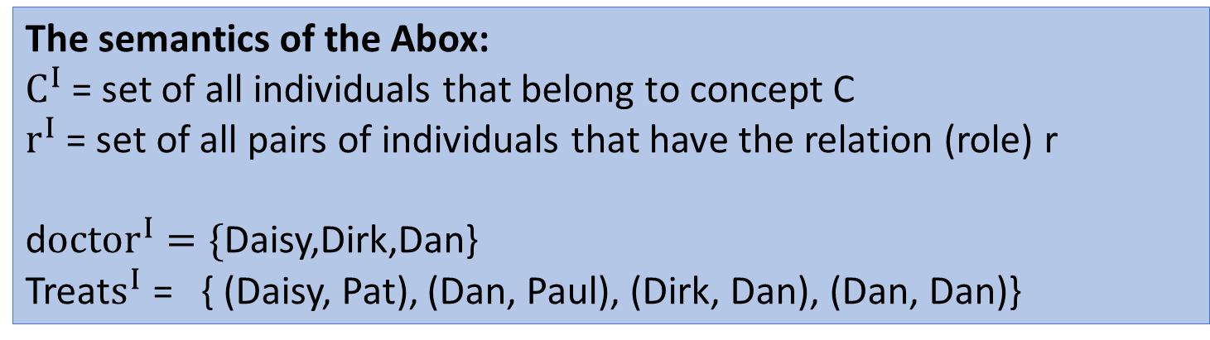
The semantics of the Abox:
$C^{I}$= set of all individuals that belong to concept C
$r^{I}$ = set of all pairs of individuals that have the relation (role) r
d$octor^{I}=\{$Daisy,Dirk,Dan} Treat$s^{I}$ = { (Daisy, Pat), (Dan, Paul), (Dirk, Dan), (Dan, Dan)}
The semantics of a Tbox will tell us when terminological axioms
($⊑$ statements and = statements) are true or false
$C⊑D is true precisely when C^{I}⊆D^{I}$
$C=D is true precisely when C^{I}=D^{I}$
An interpretation I is a model if it satisfies every terminological axiom

Slide 25
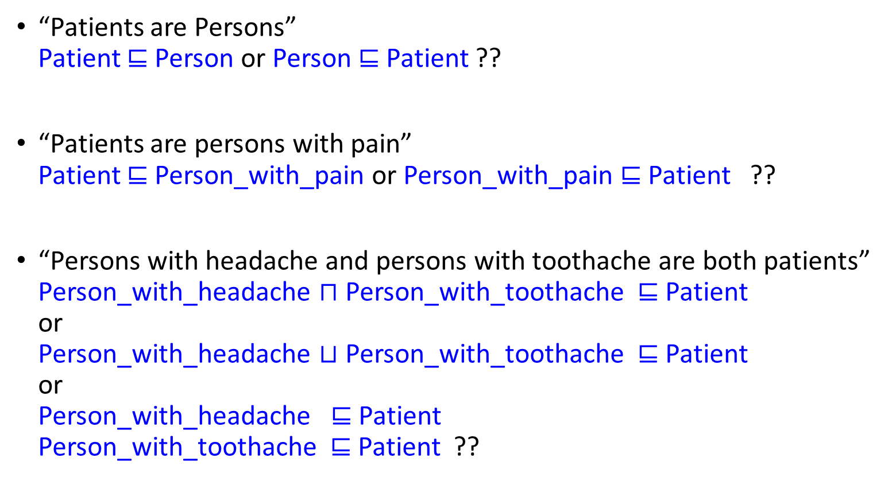
Necessary and sufficient conditions
“Patients are Persons” Patient $⊑$ Person or Person $⊑$ Patient ??
“Patients are persons with pain” Patient $⊑$ Person_with_pain or Person_with_pain $⊑$Patient ??
“Persons with headache and persons with toothache are both patients” Person_with_headache $⊓$ Person_with_toothache $⊑$Patient or Person_with_headache $⊔$ Person_with_toothache $⊑$Patient or Person_with_headache $⊑$Patient Person_with_toothache $⊑$Patient ??
Some

Slide 26
